Slide 1
Community Solar Coming Soon to a Rooftop Near You
Panelists:
Tria Case, CUNY
Ben Mandel, NYC Mayor’s Office of Sustainability
Christopher Raup, Con Edison
Moderator:
Bomee Jung, New York City Housing Authority

Slide 2






CSS Campaign and Construction
CSS in Action
Building Owner / Host Site
  Contracts with Project Owner / Developer
  Upon activation of PV receives tax credit
e⁻
$
Lease
Payment
Host Site
PV Owner & Developer
  Negotiates w/ Host
  Manages/Receives Subscriptions & Utility Billing
  Builds PV Installation
Utility
PV Owner Manages/ Maintains
Utility
Credits
Subscription Payment
Community Subscribers
  Pays subscription to PV Owner/Developer to participate in the Community Shared Solar Project
$
^{C}
CSS Subscribers

Slide 3
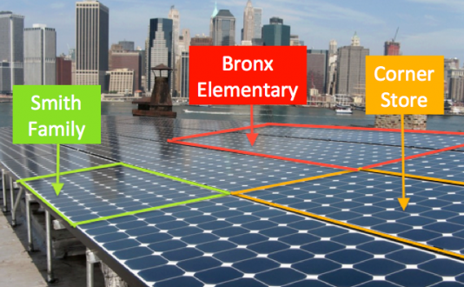
Community Solar Coming Soon to a Rooftop Near You

